Slide 2
Regression – predicting continuous target variables
Chapter 10 in Python Machine Learning TE

Slide 3


Slide 4
Summary
Regression
Visualisation, pre-checking data quality
RANSAC
Performance
High dimensions and PCR/PLS
Regularization
Polynomials and transformations
Tree based regression
Regression as the last step (compression, feature selection, …)

Slide 5
Resources
Python Machine Learning TE, Chapter 10, pages 309 – 345
Jupyter notebook : Chapter 10, part 1 + 2
Ordinary least squares in scikit-learn: http://scikit-learn.org/stable/modules/linear_model.html#ordinary-least-squares
Robustness and RANSAC in scikit-learn: http://scikit-learn.org/stable/modules/linear_model.html#robustness-regression-outliers-and-modeling-errors
Decision tree regression in scikit-learn: http://scikit-learn.org/stable/modules/tree.html
Random forests in scikit-learn: http://scikit-learn.org/stable/modules/ensemble.html#forests-of-randomized-trees

Slide 6
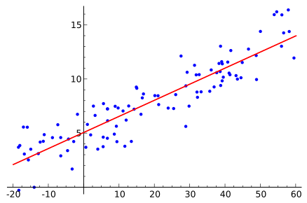
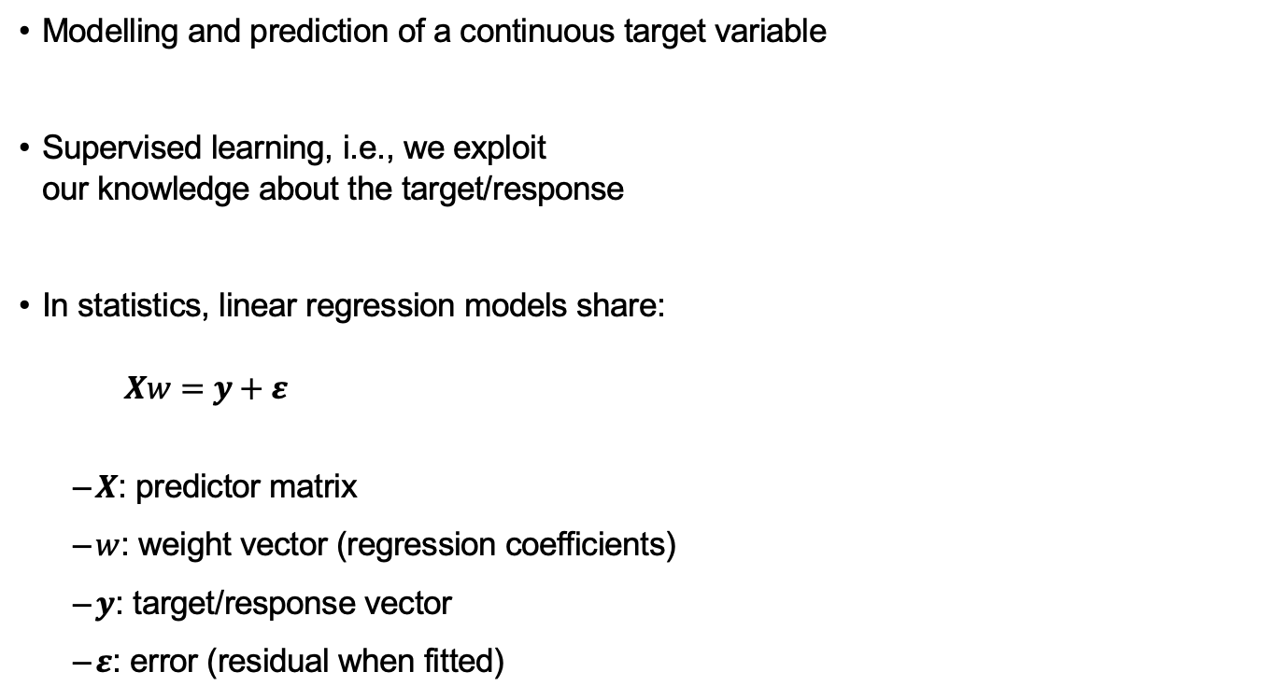
Linear regression
Modelling and prediction of a continuous target variable
Supervised learning, i.e., we exploit our knowledge about the target/response
In statistics, linear regression models share: $Xw=y+ε$
$X$: predictor matrix
$w$: weight vector (regression coefficients)
$y$: target/response vector
$ε$: error (residual when fitted)
y
x
By Sewaqu - Own work, Public Domain, https://commons.wikimedia.org/w/index.php?curid=11967659

Slide 7
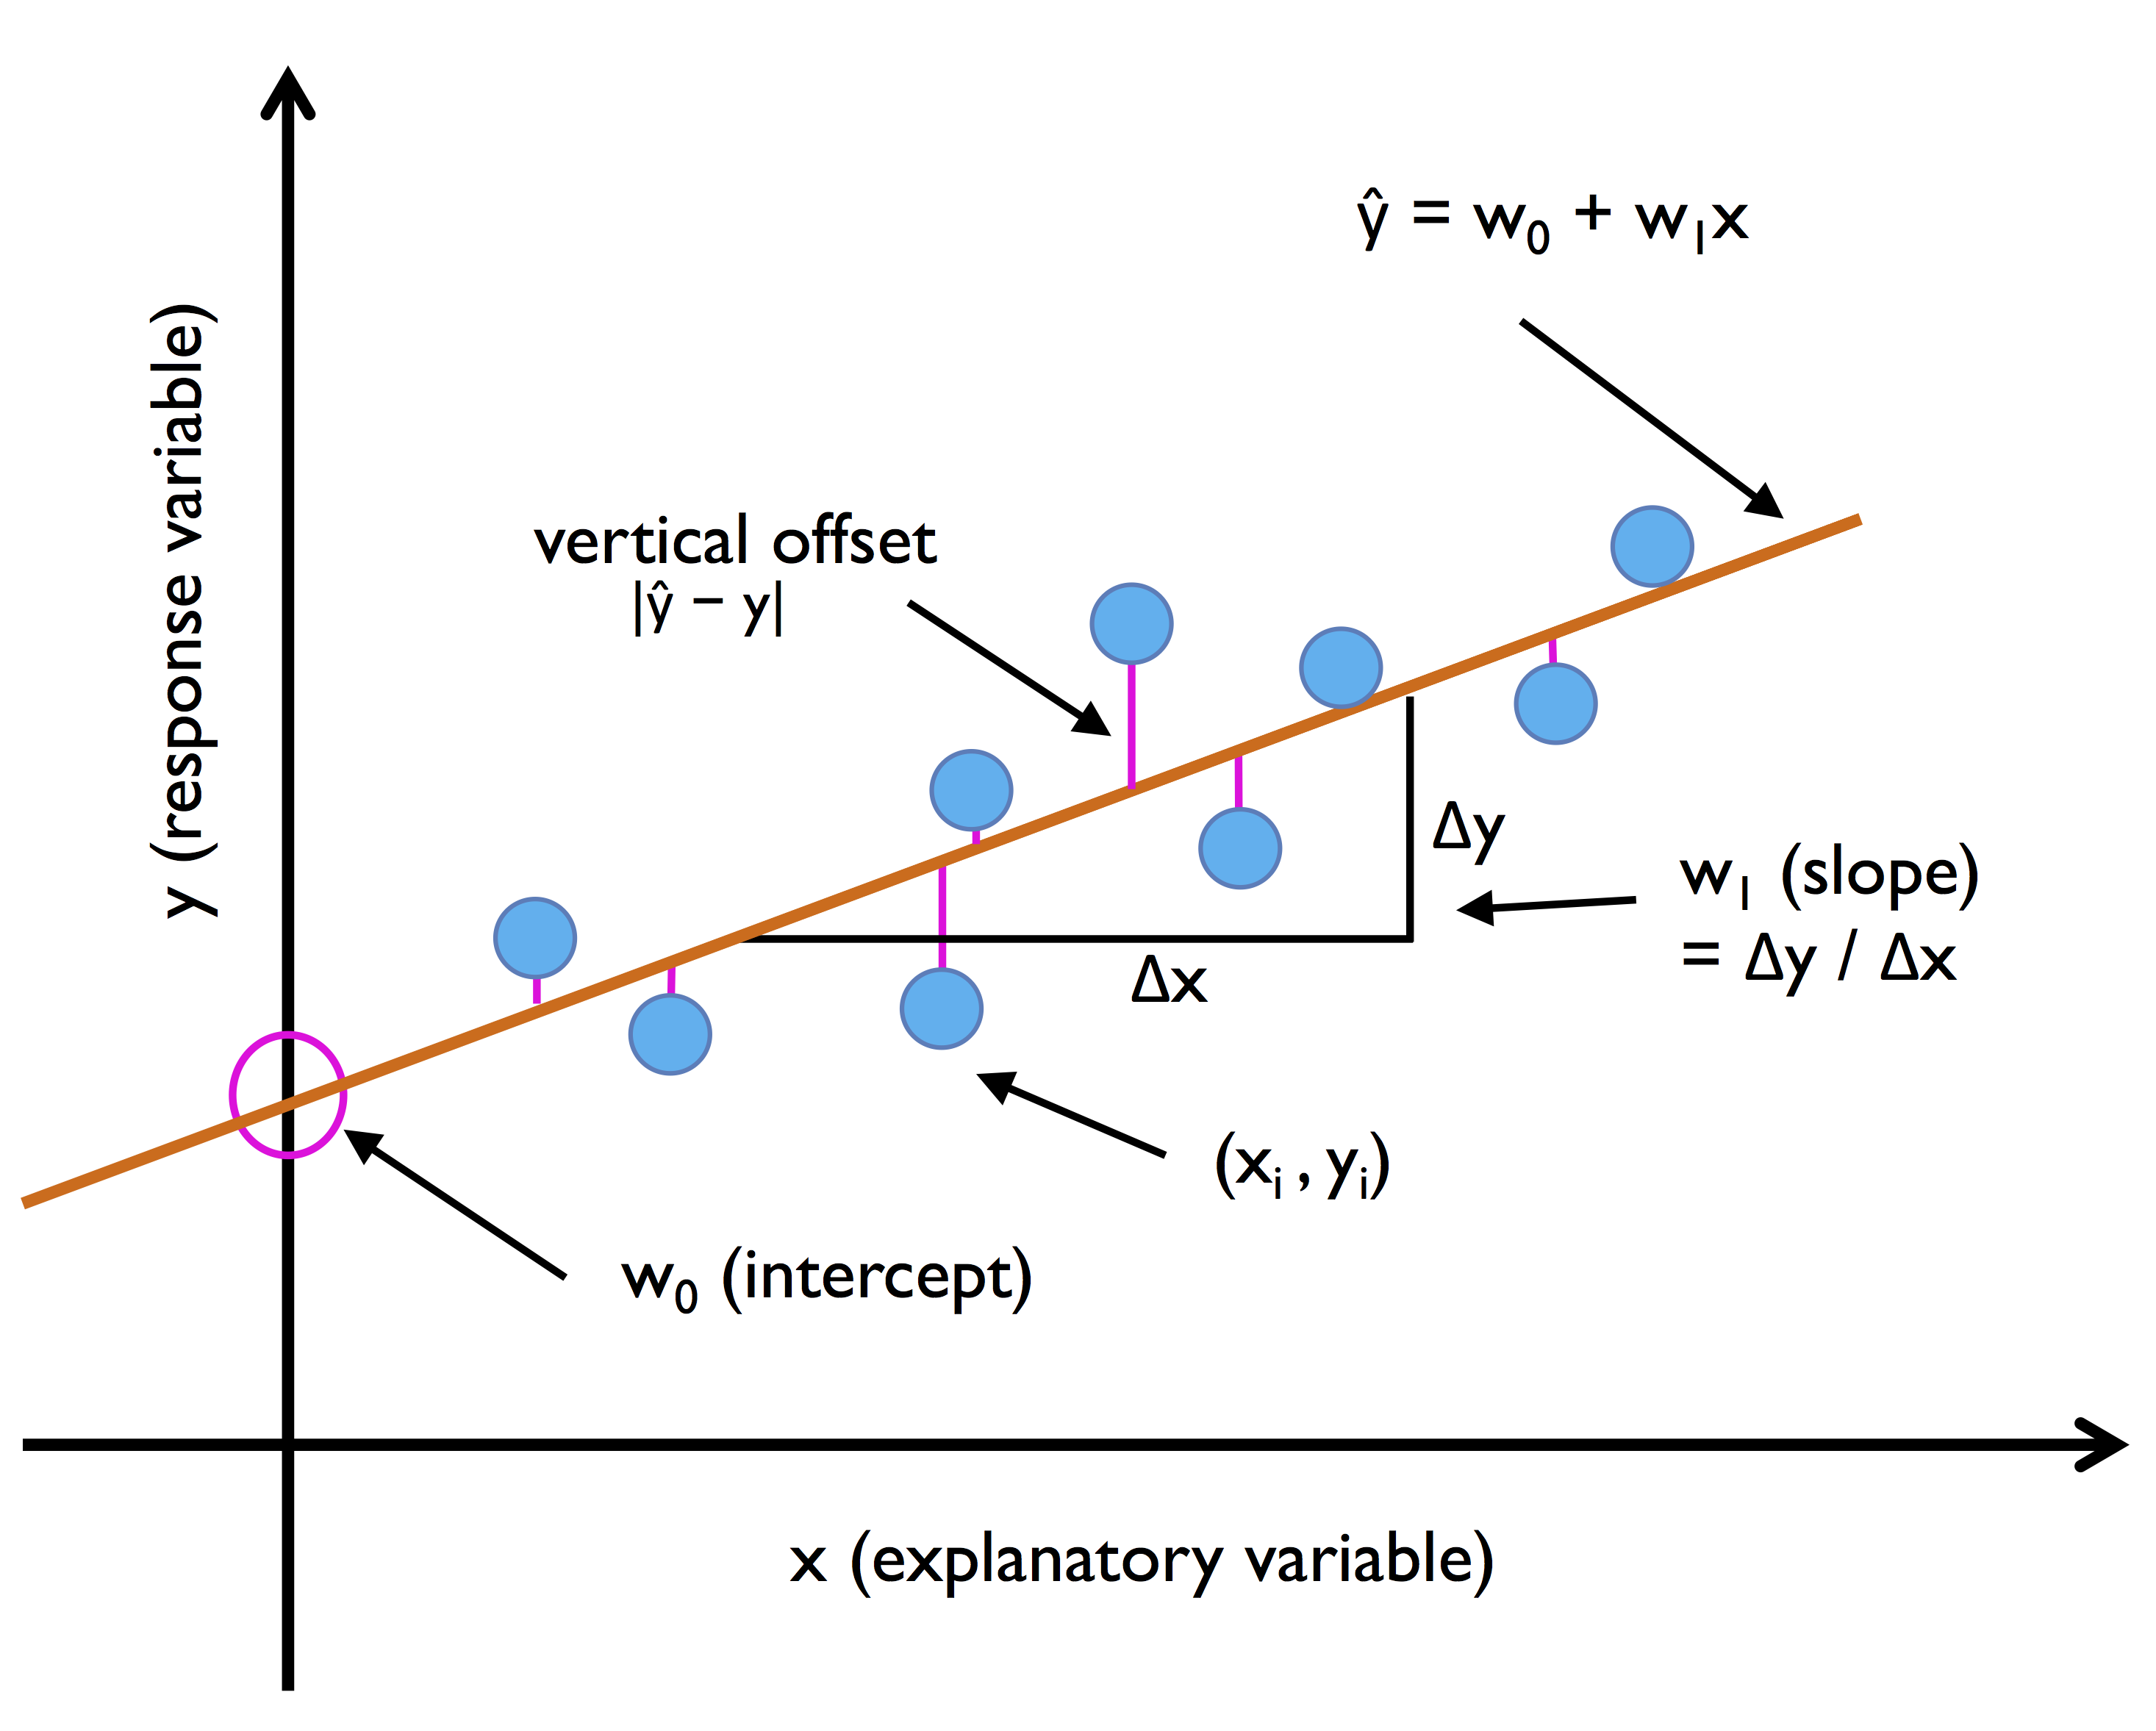
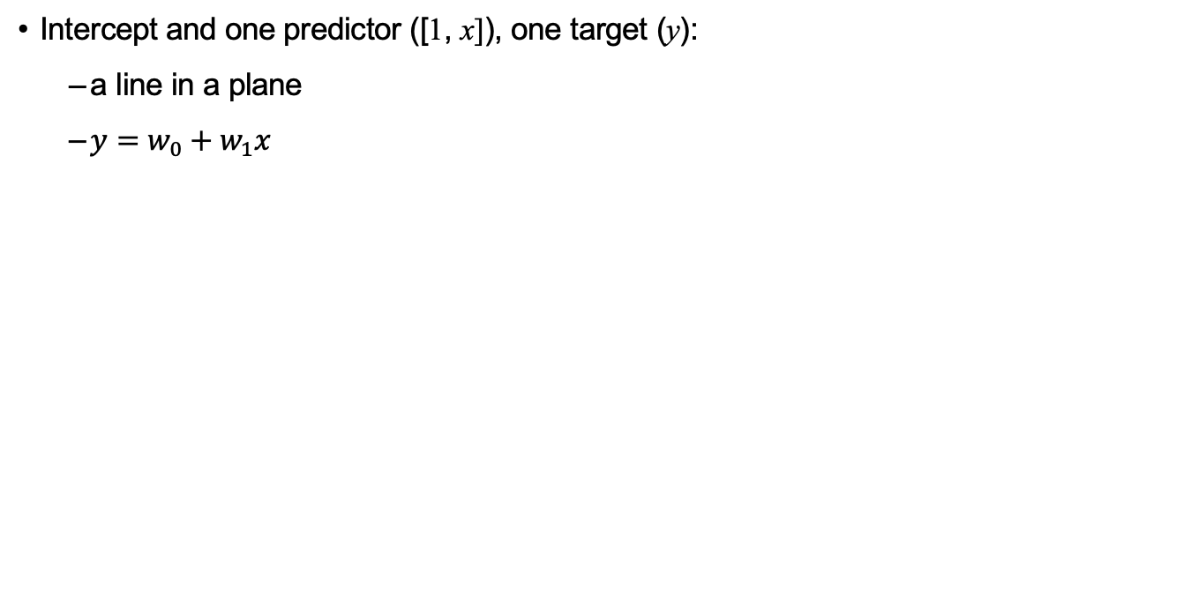
Linear regression
Intercept and one predictor ([1, x]), one target (y):
a line in a plane
$y=w_{0}+w_{1}x$
Jupyter: simple_linear_regression.ipynb

Slide 8
(Statistical) Assumptions for Linear regression
Linearity
The relationship between the variables must be linear.
Independence of errors
There is not a relationship between the residuals and the variable; in other words, is independent of errors.
Normality of errors
The residuals must be approximately normally distributed
Equal variances
The variance of the residuals is the same for all values of the response values..

Slide 9
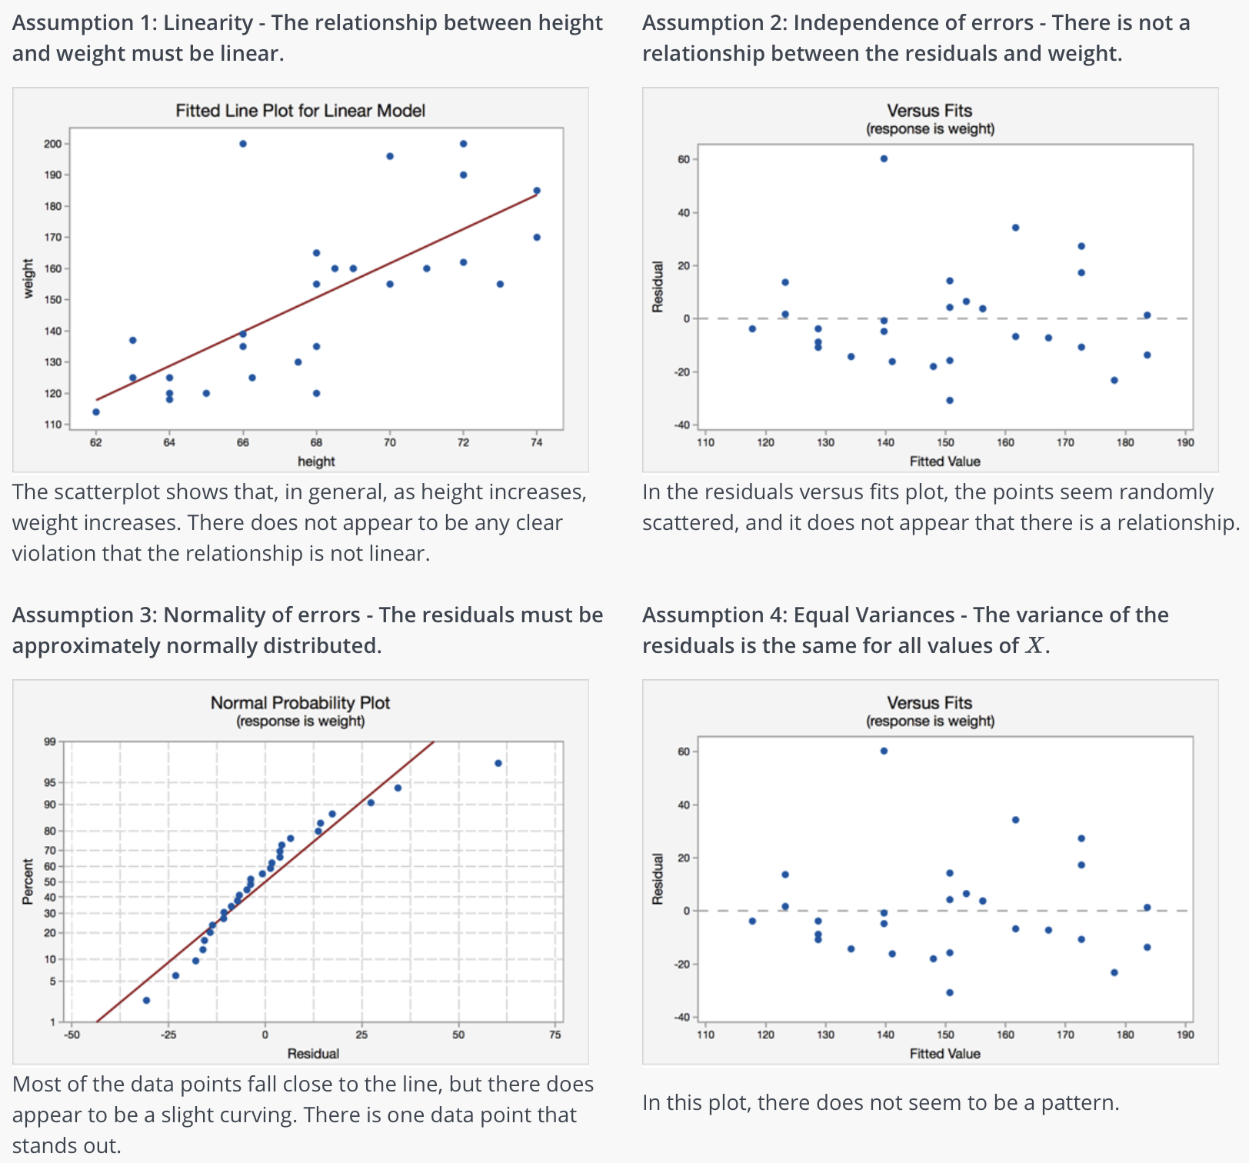
https://online.stat.psu.edu/stat500/lesson/9/9.5

Slide 10
Model assumptions
Typical assumptions in statistics:
Normally distributed errors
Large deviations indicates something is not well described
Theoretical quantile
Empirical quantile

Slide 11
Model assumptions & diagnostic plotting
Typical assumptions often emphasized in statistical analysis:
Homoscedastic noise*
Un-correlated errors
*heteroscedasticity occurs when the size of the error term differs across the independent variable’s value
Strong/systematic patterns can reveal potential for improvements in transforming/pre-processing the data.
Outliers can be seen by their large residuals (vertical deviations from the “0-line”).
In statistics residuals are often standardised, and thresholds based on 2-3 standard deviations are used to detect outliers.
Residuals
0
|
Predicted/fitted values

Slide 12
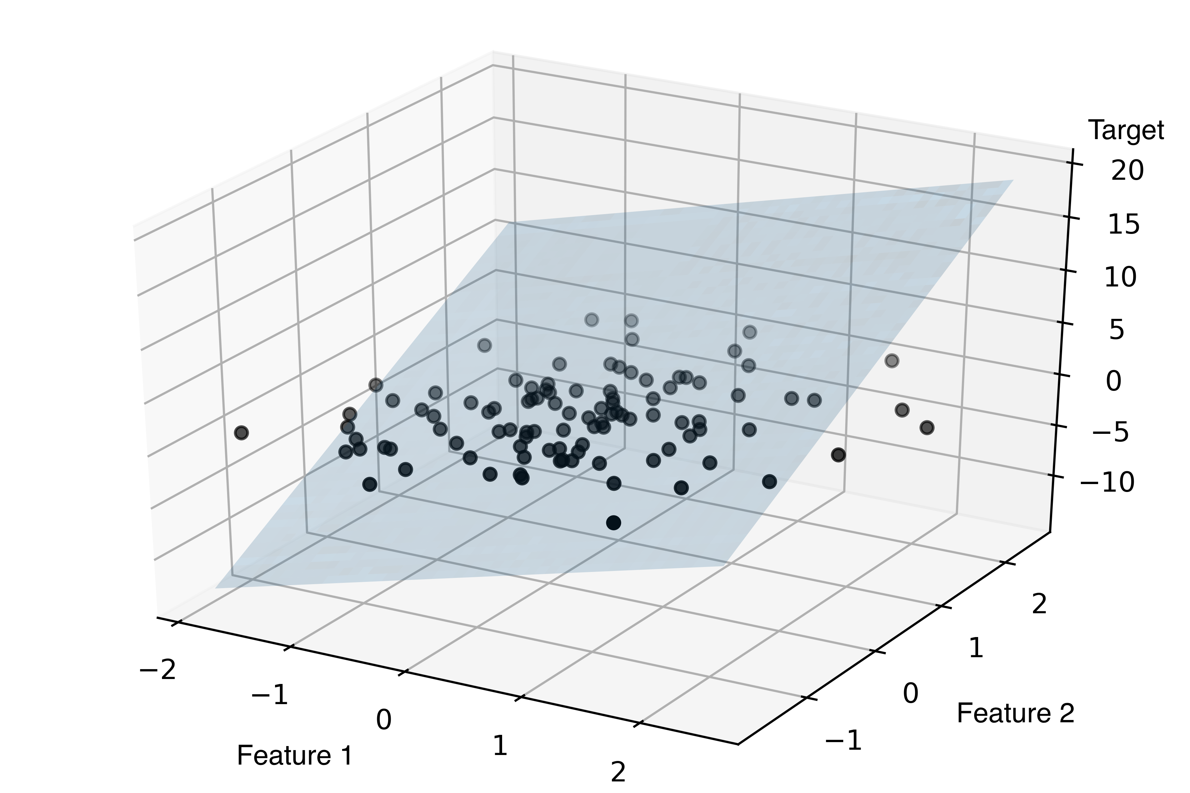
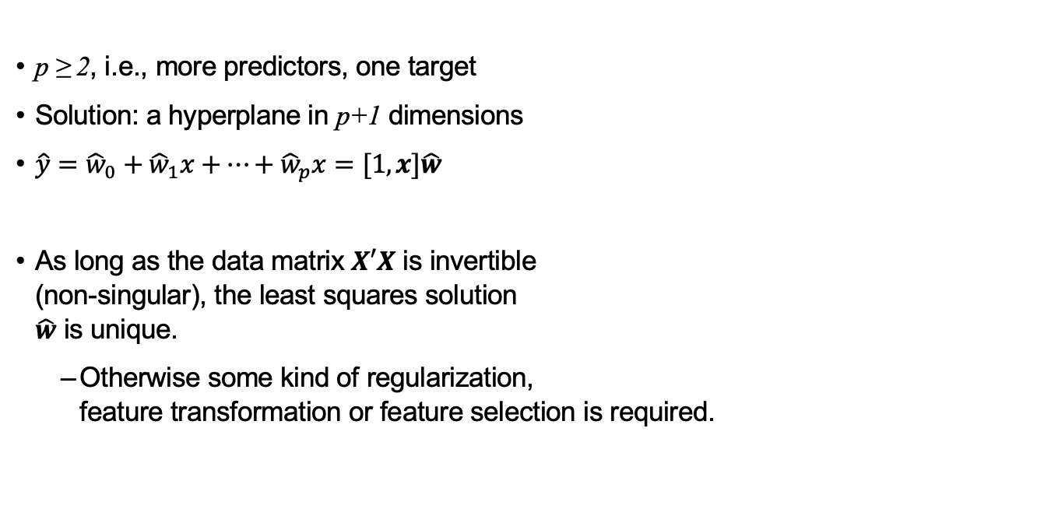
Multiple linear regression
p ≥ 2, i.e., more predictors, one target
Solution: a hyperplane in p+1 dimensions
$\hat{y}={\hat{w}}_{0}+{\hat{w}}_{1}x+…+{\hat{w}}_{p}x=[1,x]\hat{w}$
As long as the data matrix $X′X$ is invertible (non-singular), the least squares solution $\hat{w}$ is unique.
Otherwise some kind of regularization, feature transformation or feature selection is required.

Slide 13
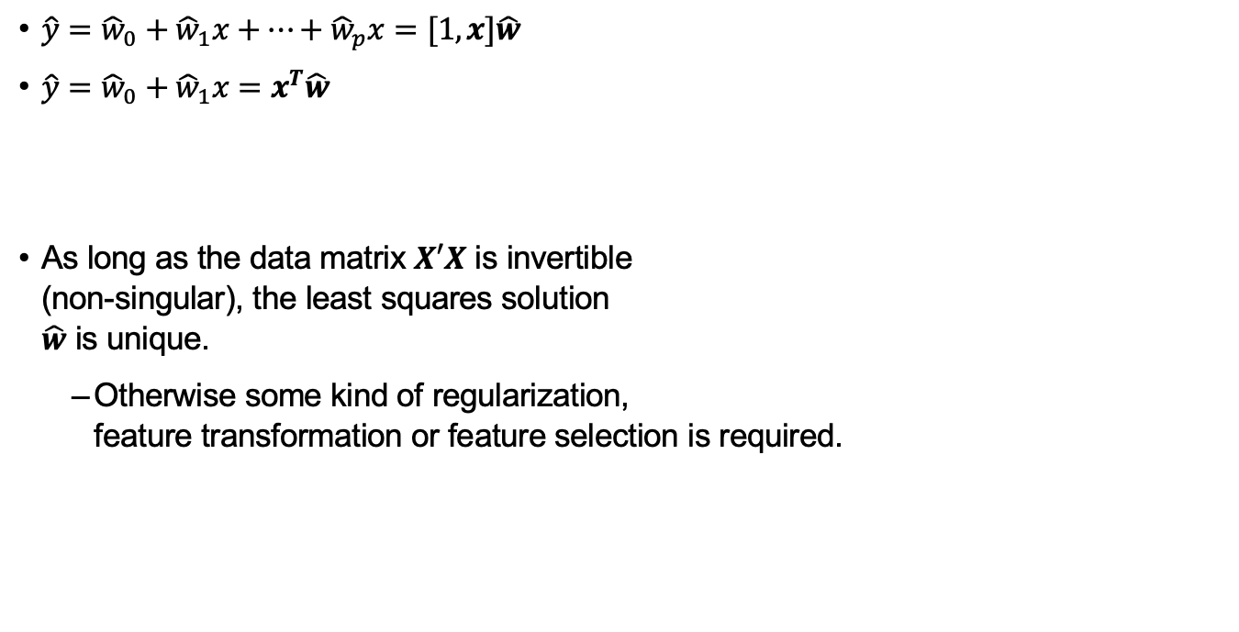
Solving linear regression
$\hat{y}={\hat{w}}_{0}+{\hat{w}}_{1}x+…+{\hat{w}}_{p}x=[1,x]\hat{w}$
$\hat{y}={\hat{w}}_{0}+{\hat{w}}_{1}x=x^{T}\hat{w}$
As long as the data matrix $X′X$ is invertible (non-singular), the least squares solution $\hat{w}$ is unique.
Otherwise some kind of regularization, feature transformation or feature selection is required.

Slide 14
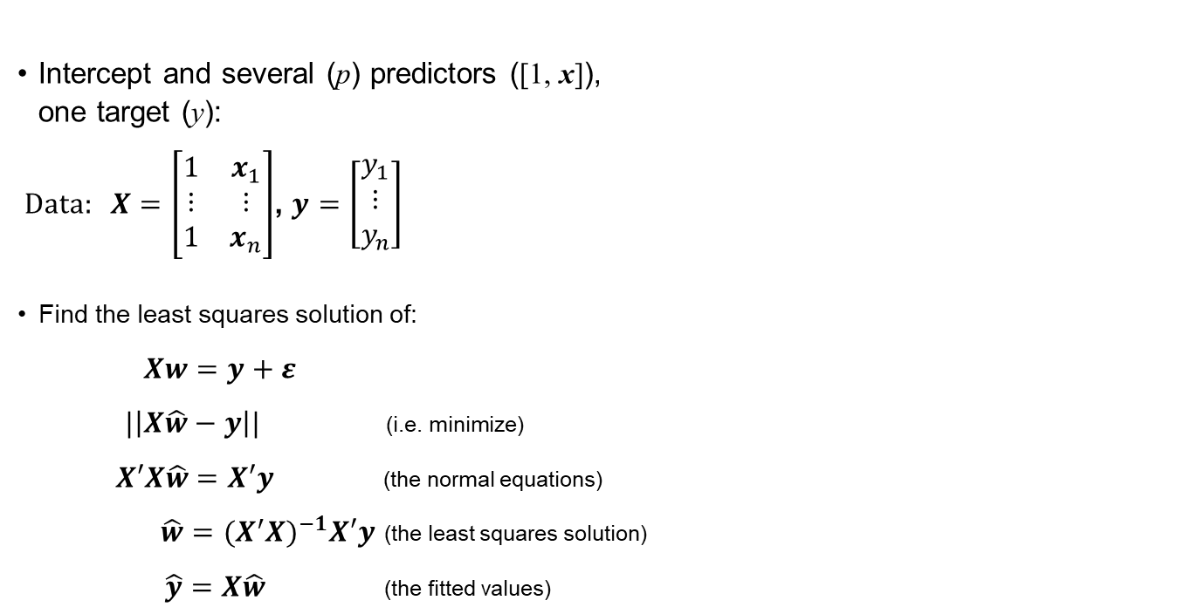
Multiple linear regression
Intercept and several (p) predictors ([1, x]), one target (y):
Data: $X=\left[\begin{matrix}1 & x_{1} \\ ⋮ & ⋮ \\ 1 & x_{n}\end{matrix}\right]$, $y=\left[\begin{matrix}y_{1} \\ ⋮ \\ y_{n}\end{matrix}\right]$
Find the least squares solution of:
$Xw=y+ε$
$|\left|X\hat{w}−y\right||$ (i.e. minimize)
$X′X\hat{w}=X′y$ (the normal equations)
$\hat{w}=(X^{′}X)^{−1}X′y$ (the least squares solution)
$\hat{y}=X\hat{w}$ (the fitted values)
Interactive demo

Slide 15
Exploratory data analysis
Initial plotting/summaries of data
An idea about possibilities
Potential non-linearities, or
high leverage points
Scatterplot matrix:
Pair-wise scatterplots
Histograms/density plots of single variables
Correlation matrix:
Pair-wise correlations of variables (linear dependence)
Multicollinearity
Jupyter: Chapter 10, part 1

Slide 16
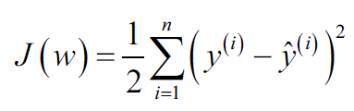
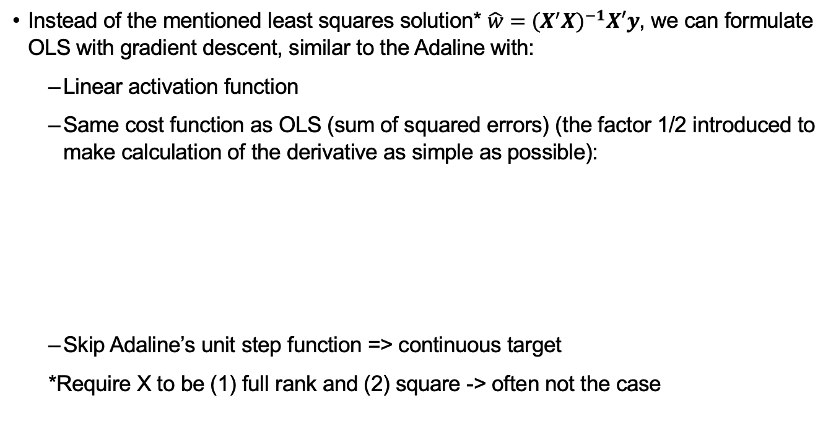
Implementing ordinary least squares
Instead of the mentioned least squares solution* $\hat{w}=(X^{′}X)^{−1}X′y$, we can formulate OLS with gradient descent, similar to the Adaline with:
Linear activation function
Same cost function as OLS (sum of squared errors) (the factor 1/2 introduced to make calculation of the derivative as simple as possible):
Skip Adaline’s unit step function => continuous target
*Require X to be (1) full rank and (2) square -> often not the case
Jupyter: Chapter 10, part 1

Slide 17

Model performance
Always try to keep your test data in the best possible condition (“mint condition”)
The test data must be held completely isolated from the model building (no tampering or peeking before the final validation).
The problem of “overfitting”:
“If you torture the data long enough, it will confess to anything” ~ Ronald Coase
Proper validation is required to assess the best possible model performance (and to avoid overfitting).

Slide 18
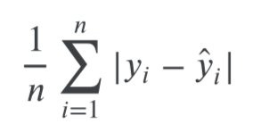
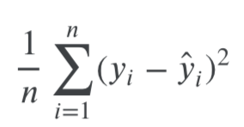
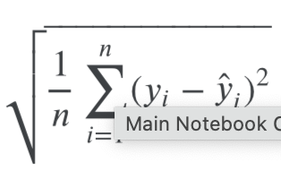
Performance metrics
Performance metrics: evaluate the model with the goal of identifying how well the model performs on new data.
Mean Absolute Error (MAE)
Consistency of error magnitude
Mean Squared Error (MSE)
Sensitive to large errors
Root Mean Squared Error (RMSE)
MSE, but restores the unites

Slide 19
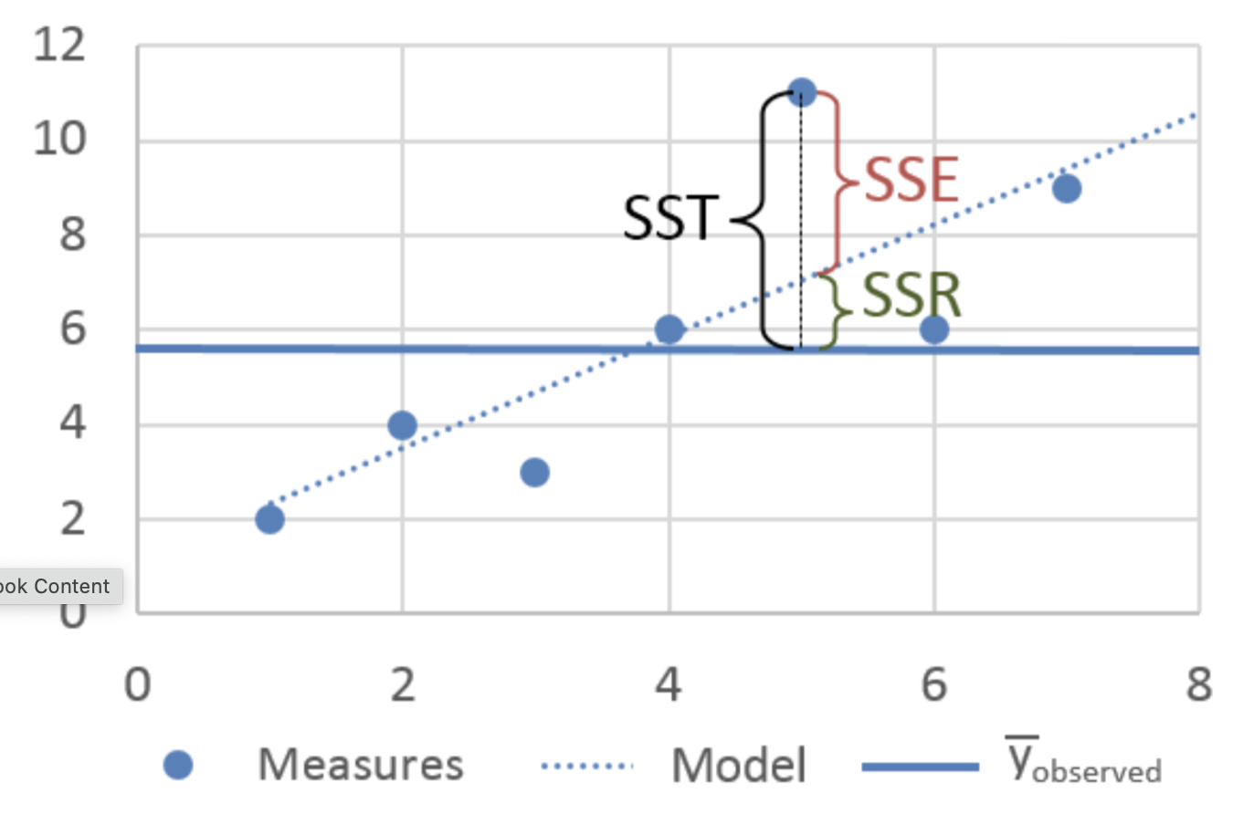
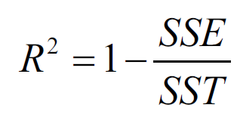
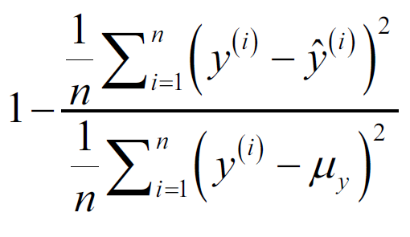
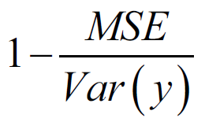
R² - Coefficient of Determination
R-squared represents the proportion of the variance in the dependent variable which is explained by the linear regression model.
The Sum of Squares Total (SST) is the squared differences between the observed dependent variable and its mean.
Sum of Squares Regression (SSR) - is the sum of the differences between the predicted value and the mean of the dependent variable. (response variance)
Sum of Squares Error (SSE) - the difference between the observed value and the predicted value.

Slide 20
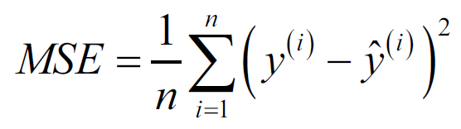
Performance metrics
Mean Squared Error:
Coefficient of determination:
Jupyter: Chapter 10, part 1

Slide 21
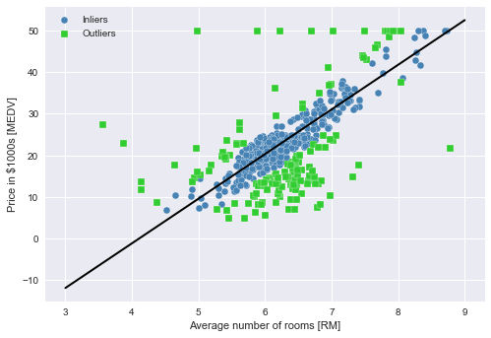
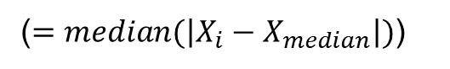
RANSAC - RANdom Sample Consensus
Background:
Estimation of outliers is complicated
Robust regression built on estimated inliers
Problem dependent thresholds
RANSAC:
Random set of inliers, fit model
Test excluded samples for user-defined inlyingness, e.g., MAD based
Refit including extra inliers
Estimate error of fitted model for the inliers
Terminate if performance meets user requirement or max iterations, otherwise repeat from start.
https://en.wikipedia.org/wiki/Random_sample_consensus
($=median(\left|X_{i}−X_{median}\right|)$)
Jupyter: plot_ransac.ipynb

Slide 22
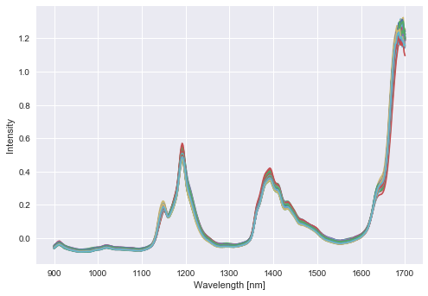
High-dimensional data
In spectroscopy data matrices
Wavelengths
Financial data
‘Unlimited’ number of factors
Genomics
3 billion DNA base pairs and their interactions
Curse of Dimensionality
(Multi)collinearity
Statistical significance (less reliable/false results, R²)
X

Slide 23
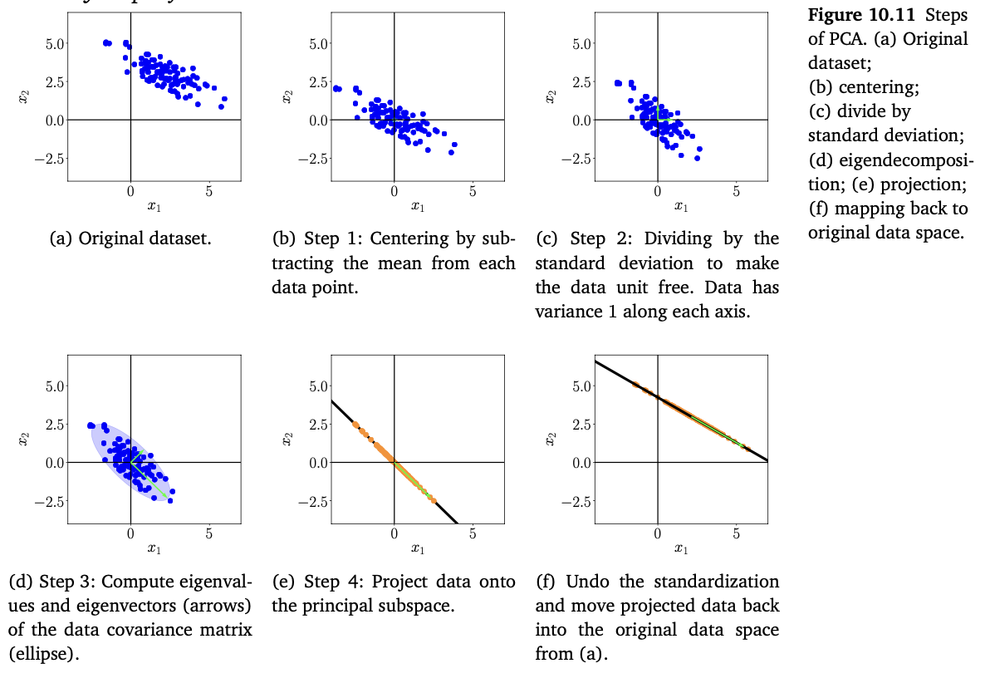

PCR (PCA Regression)
Principle components as the regressor
Perform PCA on your data matrix
Use OLS to regress observed outcome (to get the regression coefficients)
(Transform the coefficient-vector back to scale (of the actual covariates))
Jupyter: PCA regression

Slide 24
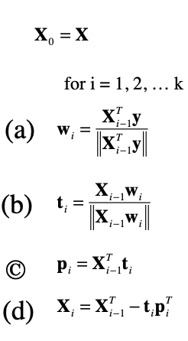
PLS* regression 🇸🇪
https://www.youtube.com/watch?v=gl0gBUbhxQU
* Partial Least Square (also called projection to latent structures)
Strongly related to PCA
successive extraction of orthogonal components (not necessarily maximum variance)
scores (t) and loadings (p) (object and feature coordinates),
works best with correlated features, e.g., #objects < #features,
but …
maximizes covariance between X and y,
Orthogonalize on extracted component and calculate new loading weights.
(covariance, normalized)
additional resource
Jupyter: Chapter 10, part 1

Slide 25
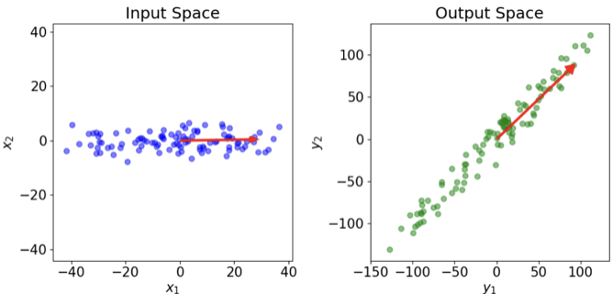
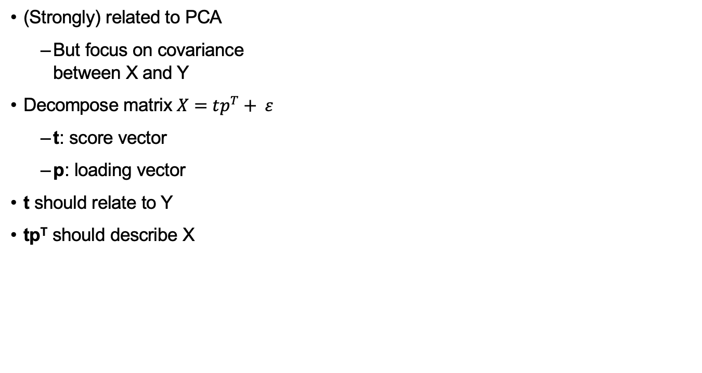
PLS* regression 🇸🇪
* Partial Least Square (also called projection to latent structures)
(Strongly) related to PCA
But focus on covariance between X and Y
Decompose matrix $X=tp^{T}+ ε$
t: score vector
p: loading vector
t should relate to Y
tp^{T} should describe X
p^{t}_{(i)}
X (n x p)
Y
=
Model
x_{(i)}
t_{(i)}
additional resource
Jupyter: Chapter 10, part 1

Slide 26
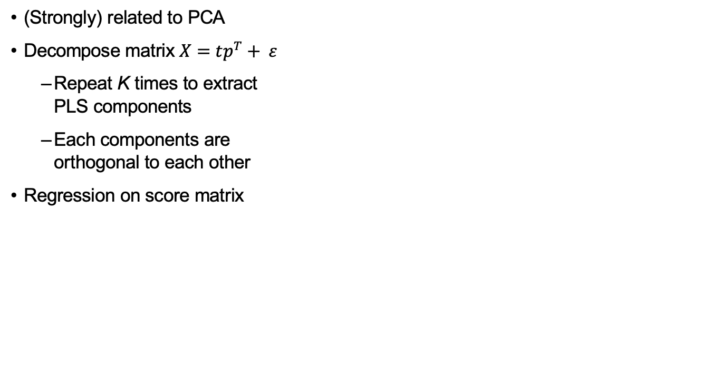
PLS* regression 🇸🇪
* Partial Least Square (also called projection to latent structures)
(Strongly) related to PCA
Decompose matrix $X=tp^{T}+ ε$
Repeat K times to extract PLS components
Each components are orthogonal to each other
Regression on score matrix
p^{T}
X (n x p)
K
Y
=
Model
Y
T (n x k)
w
K PLS component
=
t
additional resource
Jupyter: pls_regression.ipynb

Slide 27
PCR vs PSL
 | PCR | PLS
Advantages | Dimensionality reduction - effective at reducing the dimensionality of data | Covariance - between the predictors and the response is targeted
 | Multicollinearity – By using PC’s the problems of multicollinearity is reduced | Multicollinearity – also handles multicollinearity well
 | Interpretation - The PC regressors can (sometimes) be interpreted | Small data sets - PLS can work effectively even with a smaller number of observations
Disadvantages | Variance-Capture - capturing the variance in the predictors, not the variance that is most predictive of the response variable. | Complexity - computationally intensive and possibly harder to implement or interpret
 | Information Loss - By ignoring smaller principal components | Interpretability - components are a combination of directions that explain both the predictors and the response.
 | Response Variable - PCR does not consider the response variable when determining the PCs | Overfitting Risk - maximize covariance risks overfitting
Ease of use > accuracy
predictive space > predictive model

Slide 28
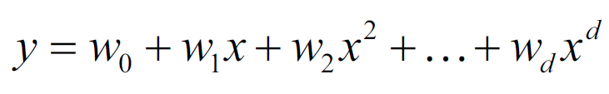
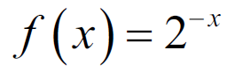
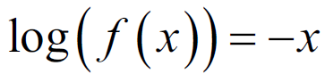
Transformations in regression
Non-linear patterns in “residuals vs fitted values”, “response vs features”, “scatter plot matrix”, …
Transform predictors or target
Polynomials, log, Box-Cox (scipy.stats), …
Beware of overfitting!
Predictor transformation:
Target transformation: (assuming a relationship)
Beaver of overfitting

Slide 29

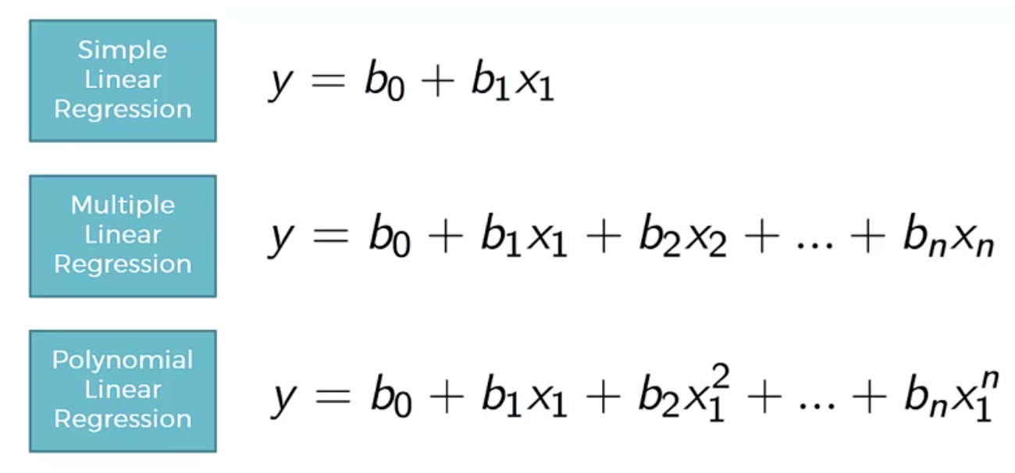
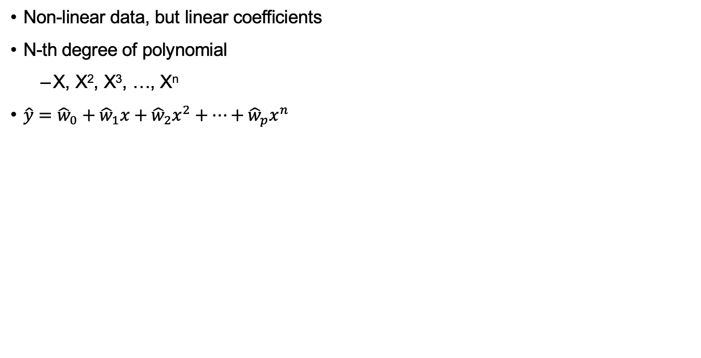
Polynomial regression
Non-linear data, but linear coefficients
N-th degree of polynomial
X, X², X³, …, X^{n}
$\hat{y}={\hat{w}}_{0}+{\hat{w}}_{1}x+{\hat{w}}_{2}x^{2}+…+{\hat{w}}_{p}x^{n}$
Jupyter: polynominal_regression.ipynb

Slide 30
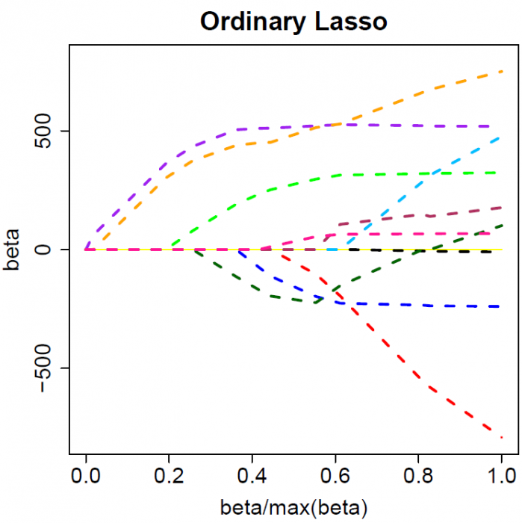
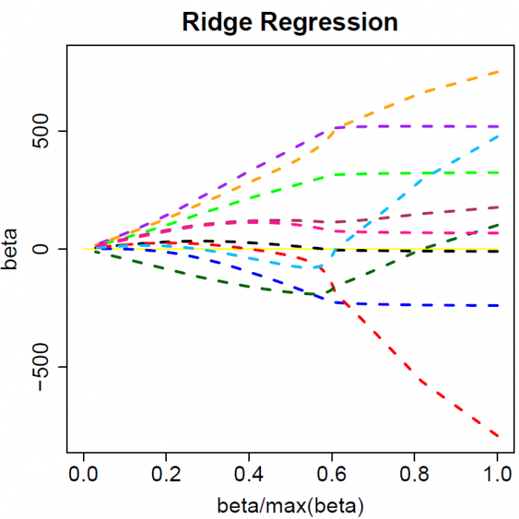
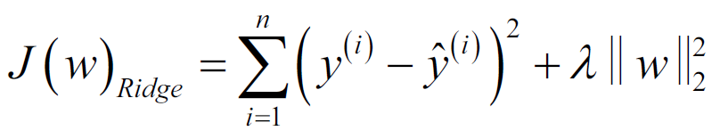
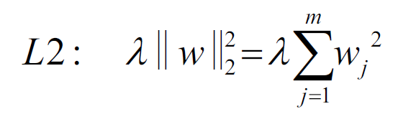
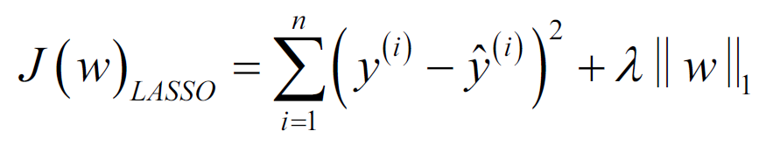
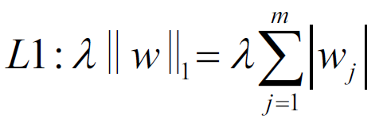
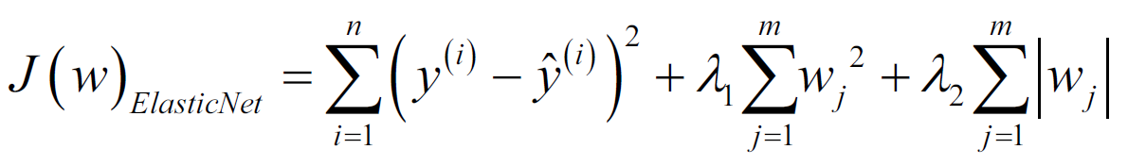
Regularization
OLS:
Ridge:
Lasso:
Elastic net:
(can be reformulated as a linear SVM)
OLS

Slide 31
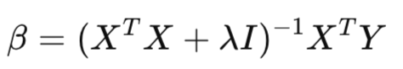
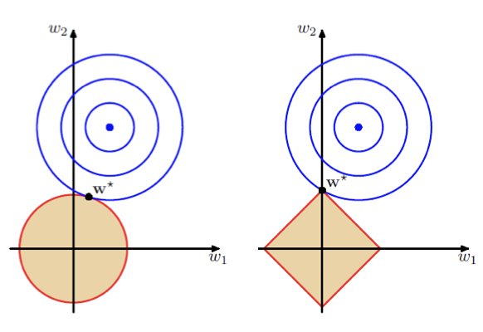
Regularization
L2:
Mathematically: always invertible, eigenvalues away from zero
Geometrically: (hyper-) sphere constrains
Conceptual: shrinking of the coefficients
L1:
Mathematically: absolute value
Geometrically: polytope constraints
Conceptual: sparsity of the coefficients
L2
(Ridge)
L1
(Lasso)
Jupyter: regularization.ipynb

Slide 32
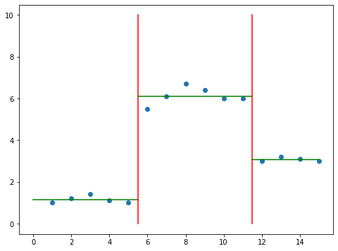
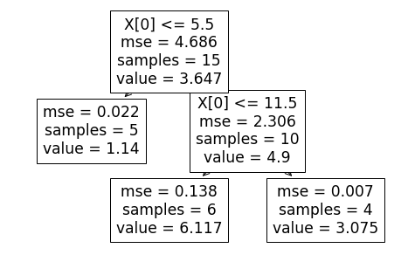
Decision tree regression
Local, piecewise linear modelling
Instead of global modelling
Can approximate most non-linear relationships without transformation
Decision tree feature splitting by Information Gain (choosing which feature, and which value to split at):
Classification: Gini impurity
Regression: MSE
Jupyter: decision_tree.ipynb
Notes:
IG: Reduction of error on both sides of the split (weighted by number of samples on each side)

Slide 33
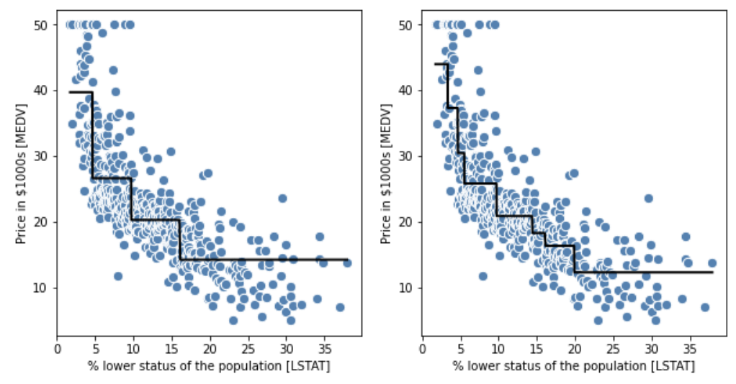
Random forest regression
Generalisation of decision trees corresponding to classification:
Use MSE for tree growing
Predict by average over all trees
Prone to overfitting
RF samples both objects and features
Jupyter: Chapter 10, part 2
Notes:
Illustrate using drawing, emphasize subsets of features and samples. Look at documentation.

Slide 34
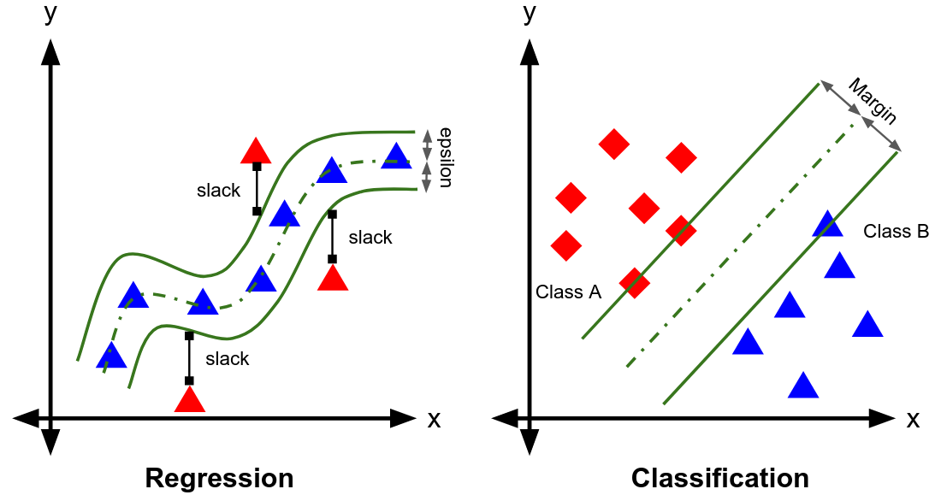
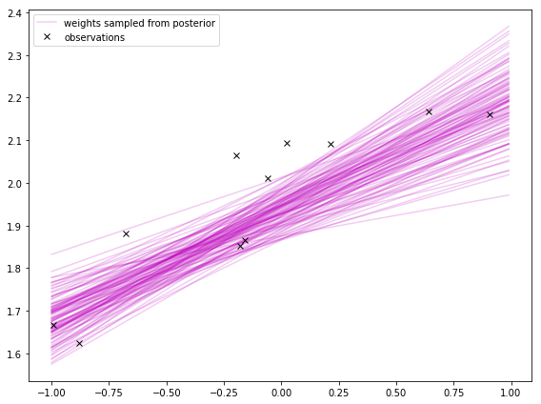
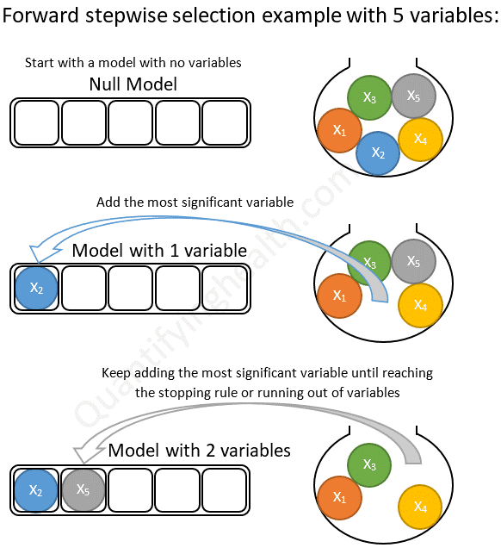
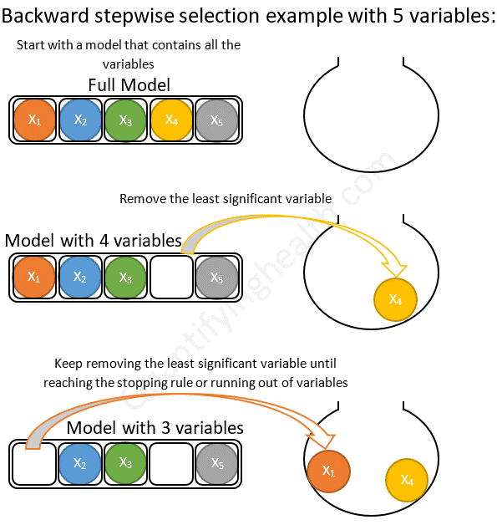
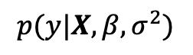
Other types of Regression
Support Vector Regression (SVR)
Stepwise Regression
Forwards and Backwards
Bayesian Linear regression
$$p(y|X, β, σ^{2})$$

Slide 35

Regression as the last step of …
Several steps, e.g.:
feature transformation,
feature engineering,
data compression, and/or
feature selection, before
regression
(or classification)
NOTE: Many of the above steps can be pipelined…

Slide 36
Summary
Exploratory data analysis:
Plot and summarize before analysis
Errors, relationships, potentials
OLS can be formulated as GD
Regression still works if #features >> #objects (if treated properly)
Outlier robustness through RANSAC
Residuals vs fitted values
Model assumptions
Patterns leaking into residuals
Transformations
RMSE as alternative to MSE
Tree based regression
Beaver of overfitting

